Slide 1
Connected Particles
Pure
Pulleys
Connected Particles
Mechanics
Objects in Contact
Statistics
Force Coupling

Slide 2
Connected Particles 4 key facts
Newton’s 3rd Law
If object A exerts a force on object B, then object B exerts a force of equal magnitude but in the opposite direction on A.
Object A
Object A
Object B

Slide 3
Connected Particles 4 key facts
R
Object A
Object B exerts a contact force on object A
mg
Object B
Object A exerts a contact force on B
Object B
R

Slide 4
Pulleys
Connected Particles
Mechanics
Pulleys

Slide 5
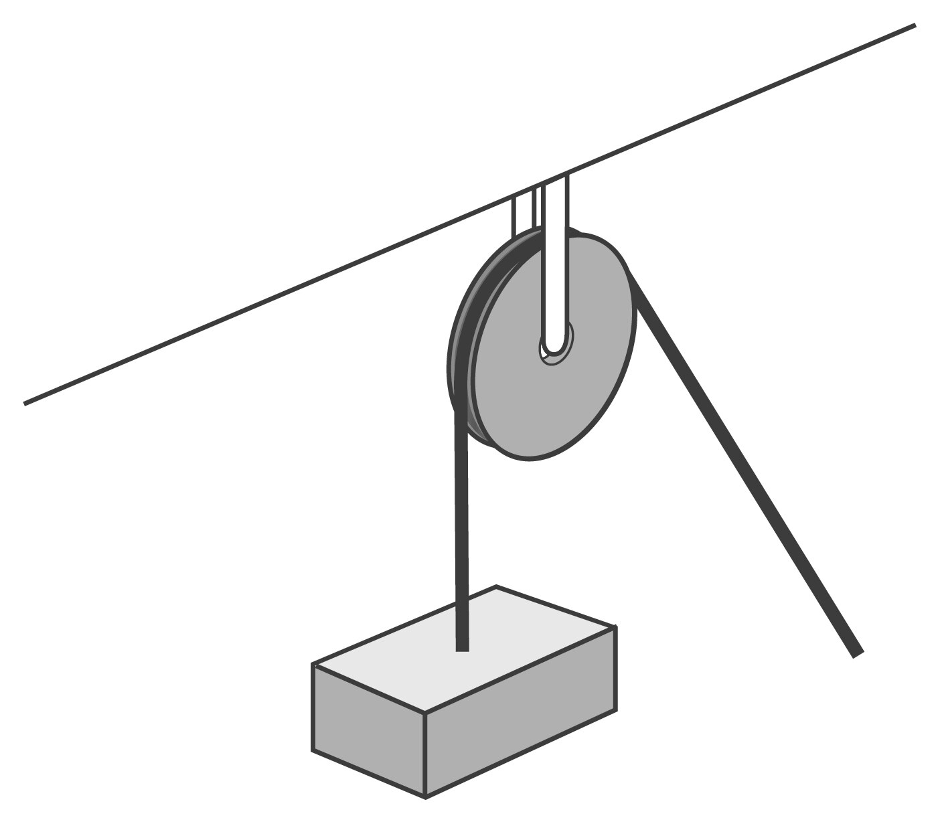
Pulleys 4 Modelling Assumptions
Pulley/Peg
© Lego Education
We model the pulley/peg as:
String
Smooth (no friction)
Fixed (stays in the same place)
We model the string as:
Light (negligible mass)
inextensible (does not stretch)

Slide 6
Pulleys Exercise – Starter Questions
Complete the three questions on the following slides.
For all questions, use $g=9.8 {ms}^{−2}$.
Ensure your working out contains:
Force diagrams.
Force equations.
Clear mathematical notation.
Check your answers using the solutions

Slide 7
Pulleys 4 Practice Questions
Q1.
Particles $A$ and $B$, of masses $5 kg$ and $8 kg$ respectively, are attached to a light inextensible string. The string passes over a smooth, fixed pulley. The particles start at the same height and are released from rest.
Find the acceleration of the particles and the tension in the string.
$$5 kg$$
$$8 kg$$
$$A$$
$$B$$
Solution on next page…

Slide 8
Pulleys 4 Practice Questions
Q1.
Particle A:
Particle A
$$\text{T}$$
(1)
Solving for T:
$$\text{A}$$
$$\text{a} {\text{ms}}^{\text{−2}}$$
Particle B
(2)
$$\text{5}\text{g}$$
Particle B:
(1) + (2) gives
$$\text{T}$$
$$\text{B}$$
$$\text{a} {\text{ms}}^{\text{−2}}$$
$$\text{8}\text{g}$$

Slide 9
Pulleys 4 Practice Questions
Q2.
A block of mass $8 kg$ rests on a smooth horizontal surface. The block is attached to a freely hanging metal sphere of mass $4 kg$ by a light, inextensible string, which passes overs a smooth fixed pulley. The system is released from rest.
(a)
Find the acceleration of the block before it reaches the pulley.
(b)
Find the tension in the string.
$$8 kg$$
$$4 kg$$
Solution on next page…

Slide 10
Pulleys 4 Practice Questions
Q2.
Block
Block
Solving for T:
$$\text{R}$$
(1)
$$\text{a} {\text{ms}}^{\text{−2}}$$
$$8 kg$$
$$\text{T}$$
Sphere
(2)
$$\text{8}\text{g}$$
Sphere
(1) + (2) gives
$$\text{T}$$
$$\text{a} {\text{ms}}^{\text{−2}}$$
$$\text{4}\text{g}$$

Slide 11
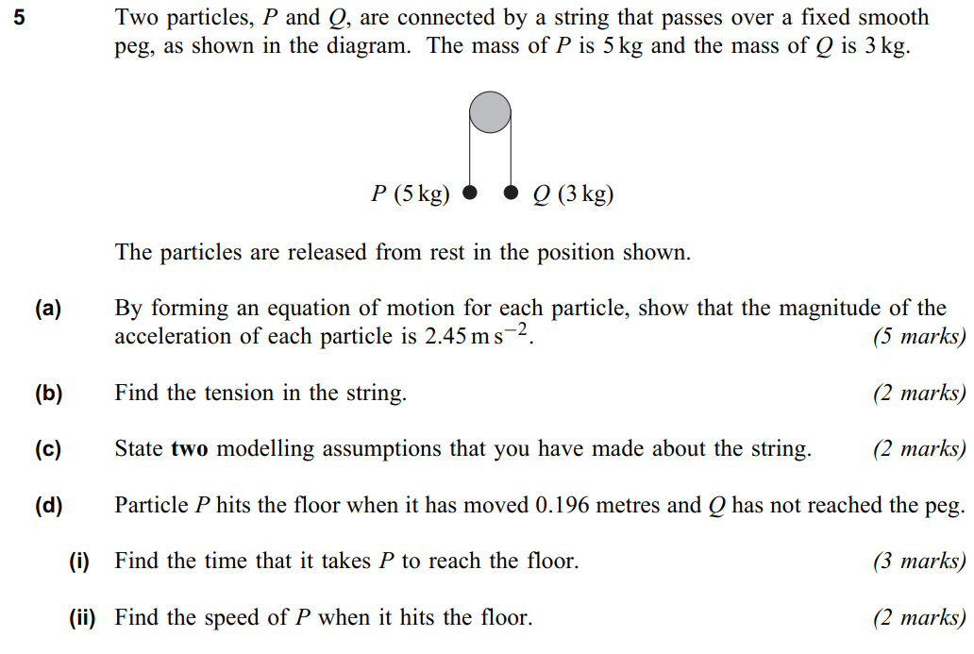
Pulleys 4 Practice Questions
Q3.

Slide 12
Pulleys 4 Practice Questions
Q3.
Particle P:
(a)
Particle A
(b)
$$\text{T}$$
(1)
Solving for T:
$$\text{P}$$
$$\text{a} {\text{ms}}^{\text{−2}}$$
Particle B
(2)
$$\text{5}\text{g}$$
Particle Q:
(1) + (2) gives
$$\text{T}$$
Don’t use rounded values
$$\text{Q}$$
$$\text{a} {\text{ms}}^{\text{−2}}$$
$$\text{3}\text{g}$$

Slide 13
Pulleys 4 Practice Questions (AQA M1 June 11 Q5)
Q3.
(c)
The string is light and inextensible.
(d)
P
0.196 m
(e)

Slide 14
Pulleys 4 Further Example-Problem Pairs
In each of the following examples, we make the following modelling assumptions:
The string is light and inextensible.
The pulley/peg is smooth and fixed.

Slide 15
Pulleys 4 Further Example-Problem Pairs
1
1E.
Two particles are connected by a string that passes over a peg. The particles have masses of 3 kg and 1 kg.
The 1 kg particle is pulled down to ground level, where it is 40cm below the level of the 3kg particle, as shown in the diagram.
The particles are released from rest.
2
3
(a)
Find the magnitude of the acceleration of the particles before the 3kg particle hits the ground.
$$3 kg$$
(b)
Find the speed of the 1kg particle when the 3kg particle hits the ground.
$$40 cm$$
$$1 kg$$
(c)
Find the maximum height above ground level reached by the 1kg particle.

Slide 16
Pulleys 4 Further Example-Problem Pairs
1
1E.
2
🗸
🗸
🗸
🗸
(b)
3
1kg Particle
$$\text{T}$$
(a)
1kg Particle
🗸
🗸
(1)
$$\text{a} {\text{ms}}^{\text{−2}}$$
3kg Particle
$$\text{g}$$
(2)
3kg Particle
$$\text{T}$$
(1) + (2) gives
$$\text{a} {\text{ms}}^{\text{−2}}$$
$$\text{3}\text{g}$$

Slide 17
Pulleys 4 Further Example-Problem Pairs
1
1E.
When the 3kg particle hits the ground, there is no longer tension in the string (the particle is in freefall).
2
3
🗸
🗸
1kg Particle (during freefall)
1 kg
40 cm
3 kg
The particle travels a further 0.2m upwards.
Height above ground $=$ 0.4 $+$ 0.2 $=$ 0.6m

Slide 18
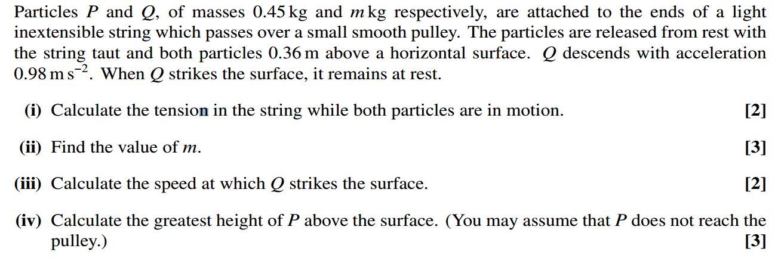
Pulleys 4 Further Example-Problem Pairs (OCR Question)
1
1P.
2
3

Slide 19
Pulleys 4 Further Example-Problem Pairs (OCR Question)
1
1P.
(i)
Particle P
2
3
Particle P
🗸
$$\text{T}$$
🗸
🗸
🗸
$$\text{0.98} {\text{ms}}^{\text{−2}}$$
(ii)
Particle Q
$$\text{0.45}\text{g}$$
🗸
Particle Q
🗸
$$\text{T}$$
$$\text{0.98} {\text{ms}}^{\text{−2}}$$
$$\text{mg}$$

Slide 20
Pulleys 4 Further Example-Problem Pairs (OCR Question)
1
1P.
🗸
🗸
(iii)
Particle Q
2
3
P
🗸
0.36 m
🗸
(iv)
Particle P (during freefall)
Q
0.36 m
Original height

Slide 21
Pulleys – Practice Questions
Suggested time: 30-40 minutes.
For all questions, use $g=9.8 {ms}^{−2}$.
Check your answers using the solutions
Question(s) | Notes
4 | Optional question – similar to example
5-6 | Minimum expected
7 | Additional question

Slide 22
Note:
The following questions are from an older AQA specification.
In the old spec, we used $g=9.8 ms^{−2}$ and gave answers to 3 s.f.
In your specification you need to use “a suitable degree of accuracy”.

Slide 23
Pulleys 4 Practice Questions (continued)
Q4.
Particles $P$ and $Q$, of masses $0.4 kg$and $m kg$ respectively, are joined by a light inextensible string which passes over a smooth pulley. The particles are released from rest at the same height above a horizontal surface.
$Q$ begins to descend with acceleration $2.45 {ms}^{−2}$ and reaches the surface $0.3 s$ after being released.
Subsequently, $Q$ remains at rest and P never reaches the pulley.
(a) Calculate the tension in the string while Q is in motion.
(b) Calculate the speed of P when Q hits the surface.
(c) Calculate the greatest height reached by P.
$$P$$
$$Q$$
Solution on next page…

Slide 24
Pulleys 4 Practice Questions (continued)
Q4.
(a)
Particle P
Particle P
$$\text{T}$$
$$\text{2.45} {\text{ms}}^{\text{−2}}$$
(b)
Particle P
$$\text{0.4}\text{g}$$
Particle Q
$$\text{T}$$
$$\text{2.45} {\text{ms}}^{\text{−2}}$$
$$\text{mg}$$

Slide 25
Pulleys 4 Practice Questions (continued)
Q4.
(c)
Particle P
Distance travelled upwards by P before Q hits ground:
Particle P
$$\text{T}$$
$$\text{2.45} {\text{ms}}^{\text{−2}}$$
$$\text{0.4}\text{g}$$
Distance travelled upwards by P during freefall:
Particle Q
$$\text{T}$$
$$\text{2.45} {\text{ms}}^{\text{−2}}$$
$$\text{mg}$$

Slide 26
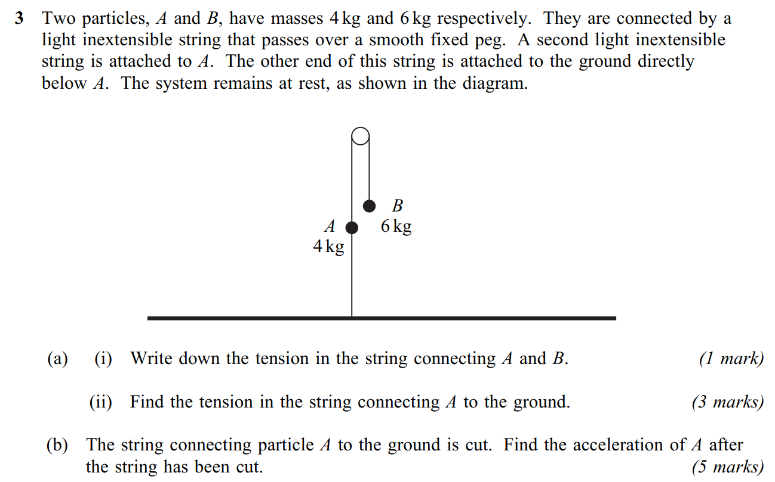
Pulleys 4 Practice Questions (continued)
Q5.
© AQA June 08

Slide 27
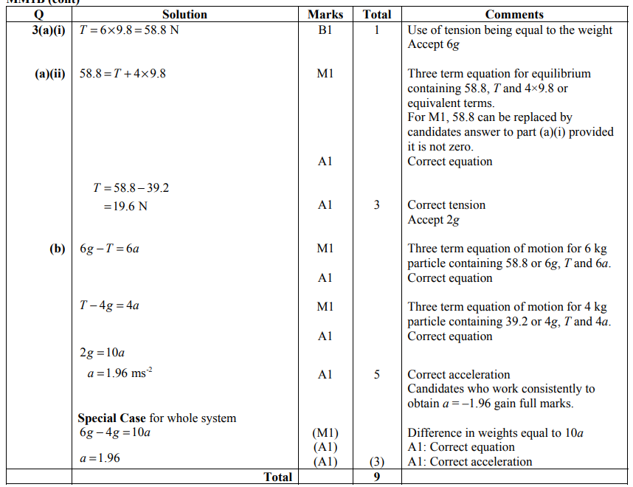
Pulleys 4 Practice Questions (continued)
Q5.
© AQA June 08

Slide 28
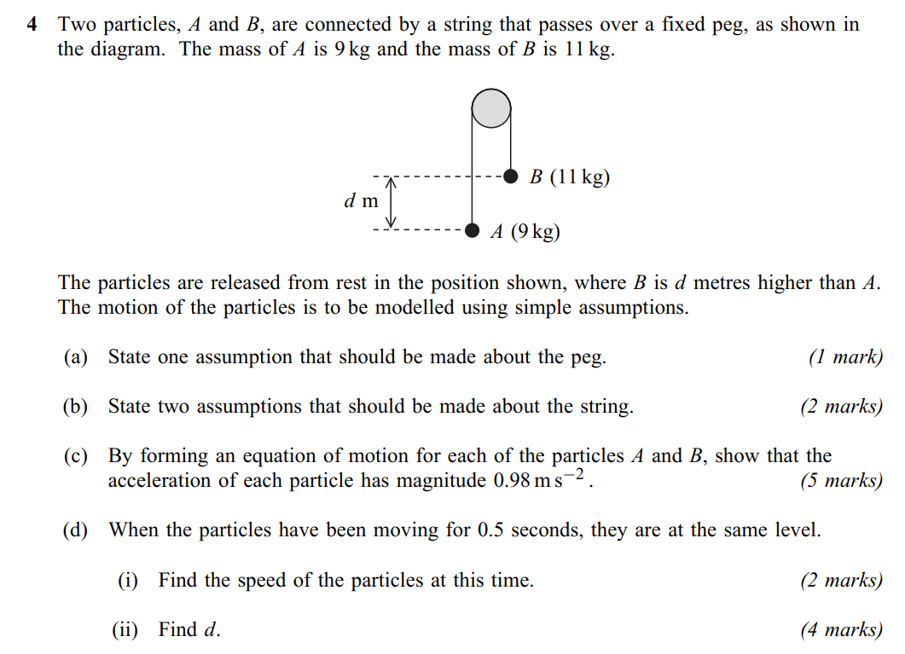
Pulleys 4 Practice Questions (continued)
Q6.
© AQA Jan 2009

Slide 29
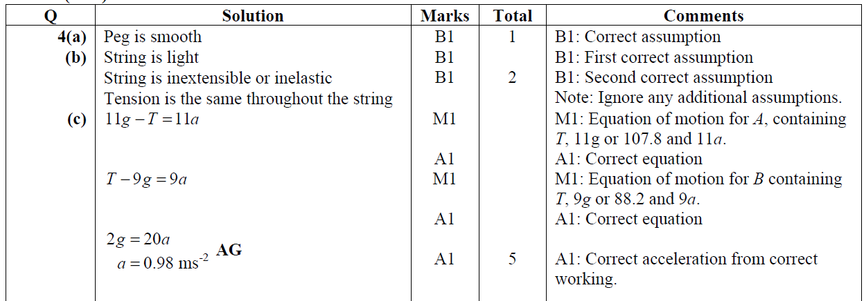
Pulleys 4 Practice Questions (continued)
Q6.
© AQA Jan 2009
Continues on next page…

Slide 30
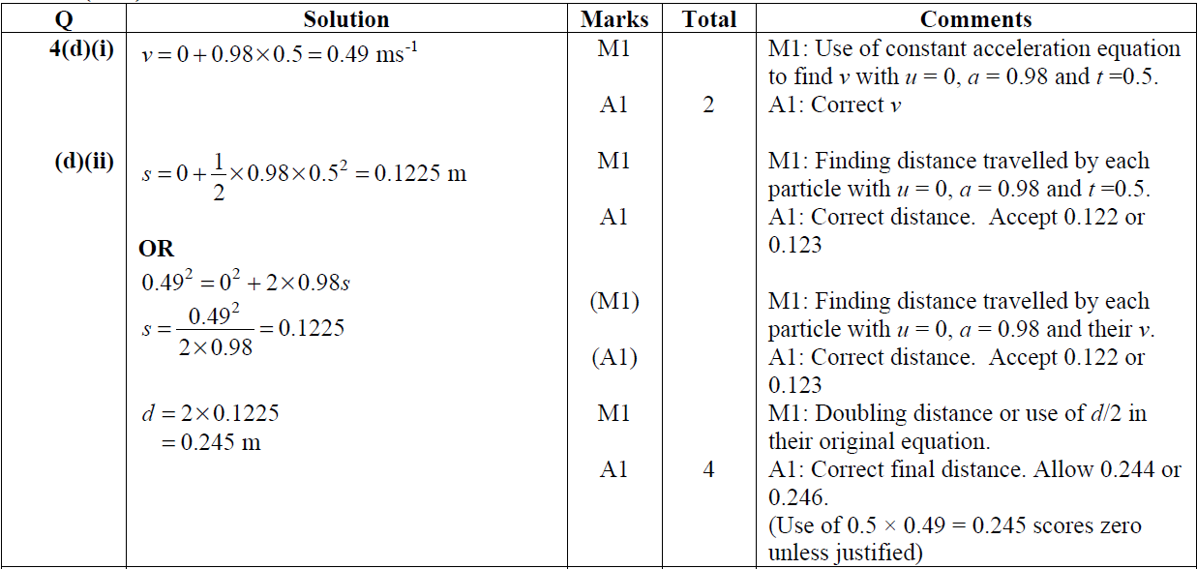
Pulleys 4 Practice Questions (continued)
Q6.
© AQA Jan 2009

Slide 31
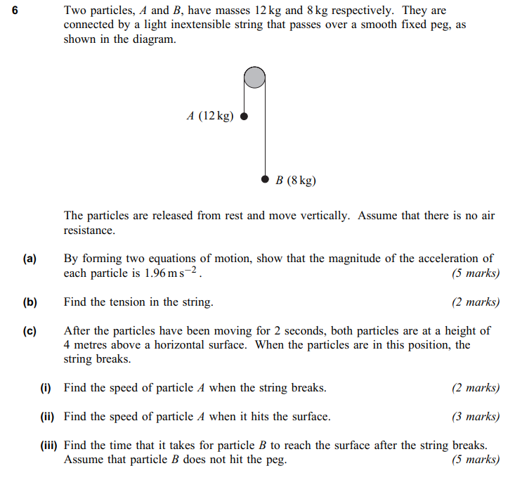
Pulleys 4 Practice Questions (continued)
Q7.
© AQA June 10

Slide 32
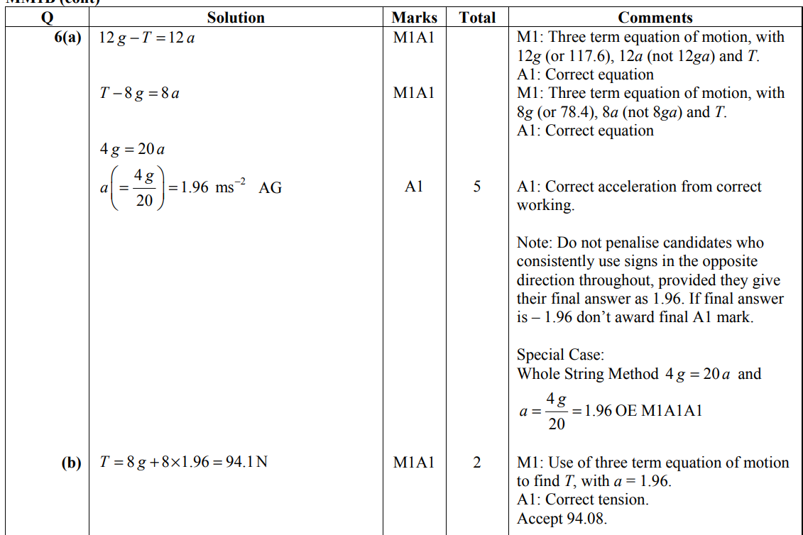
Pulleys 4 Practice Questions (continued)
Q7.
© AQA June 10

Slide 33
Pulleys 4 Practice Questions (continued)
Q7.
© AQA June 10

Slide 34
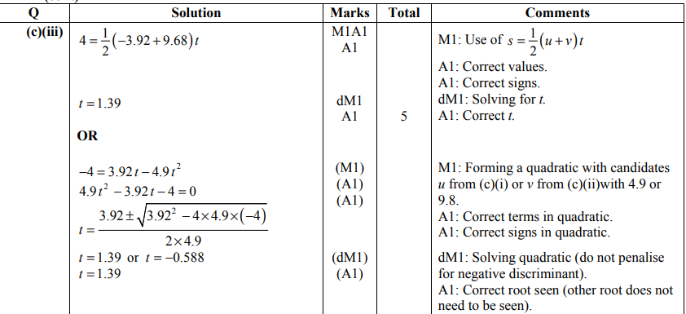
Pulleys 4 Practice Questions (continued)
Q7.
© AQA June 10

Slide 35
Force Coupling
Connected Particles
Force Coupling
Mechanics

Slide 36
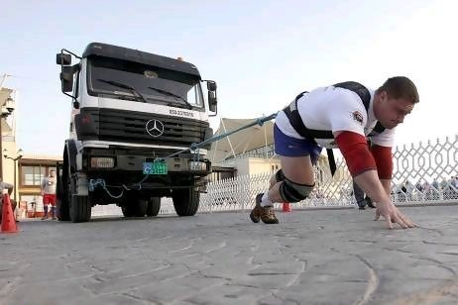
Coupling Forces
When considering forces acting on connected particles, we can consider:
The whole system.
The individual parts separately.

Slide 37
Force Coupling
Here, we could consider the following cases:
The forces on the man.
a
man
Tension in rope
Driving force
Note: We may also include other resistive forces (e.g. air resistance)

Slide 38
Force Coupling
Here, we could consider the following cases:
The forces on truck.
a
truck
Tension in rope
Note: We may also include other resistive forces (e.g. air resistance)

Slide 39
Force Coupling
Here, we could consider the following cases:
The whole system.
a
Man and truck
Driving force
Note: The mass here is the combined mass

Slide 40
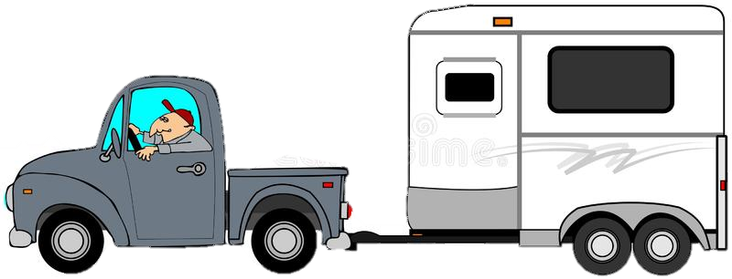
Coupling Forces 4 Example-Problem Pairs
1
1E.
A truck of mass $1200 kg$pulls a caravan of mass $400 kg$. Both the truck and caravan accelerate at $0.5 ms^{−2}$.
Motion of the caravan is resisted by a force of $140 N$.
2
3
(a)
Find the driving force produced by the engine in the truck.
(b)
Find the tension in the coupling between the truck and the caravan.

Slide 41
Coupling Forces 4 Example-Problem Pairs
1
1E.
(a)
Whole System
Working with the whole system allows us to ignore the tension.
2
🗸
🗸
🗸
3
🗸
1600 kg
140 N
D
🗸
🗸
(b)
Caravan
🗸
🗸
400 kg
140 N
T

Slide 42
Coupling Forces 4 Example-Problem Pairs
1
1E.
Part (b) alternative using the truck:
2
3
🗸
🗸
(b)
Truck
🗸
🗸
1200 kg
140 N
940 N

Slide 43
Example 1 – Internal Forces
The previous example illustrates Newton’s 3rd Law.
The force that the truck applies to the caravan is
equal in magnitude
opposite in direction
to the force that the caravan applies to the truck.
equal magnitude
opposite direction
T
T
140 N
D

Slide 44
Example 1 – Internal Forces
INTERNAL FORCES
T
T
140 N
D
Internal forces cancel out when working with the whole system*.
* Provided the velocity and acceleration of both objects is equal.

Slide 45
Coupling Forces 4 Example-Problem Pairs
1
1P.
A car of mass $780 kg$ is pulling a trailer of mass $560 kg$ by means of a light, inextensible cable.
The engine produces a driving force of magnitude $1800 N.$
The total resistance forces on the car and the trailer are $800 N$ and $600 N$ respectively.
2
(a)
Find the acceleration of the car.
(b)
Find the tension in the cable.
Give your answers to $3$ significant figures.

Slide 46
Coupling Forces 4 Example-Problem Pairs
1
1P.
(a)
Whole System
2
🗸
🗸
🗸
🗸
1340 kg
1400 N
1800 N
(b)
Trailer
🗸
🗸
🗸
🗸
560 kg
600 N
T

Slide 47
Coupling Forces – Practice Questions
Suggested time: 30-40 minutes.
Where required, use $g=9.8 {ms}^{−2}$.
Check your answers using the solutions
Question(s) | Notes
1-4 | Minimum expected
5-6 | Additional questions

Slide 48
Coupling Forces 4 Exercise
Q1.
A car of mass $800 kg$is pulling a trailer of mass $200 kg$. Each of the car and the trailer experience a resistance of $200 N$. The car and the trailer are accelerating at $1.3 {ms}^{−2}.$
✓/✗
(a)
Calculate the driving force of the car.
1700 N
460 N
(b)
Calculate the tension in the tow bar between the car and the trailer.
Q2.
When a car of mass $1350 kg$tows a trailer of mass $250 kg$ along a horizontal straight road, the resistive forces on the car and trailer have magnitude $200 N$and $50 N$ respectively.
Find the magnitude of the driving force on the car when the car and trailer are travelling at constant speed and state the tension in the towbar in this case.
✓/✗
250 N, 50 N
Questions continue on next page…

Slide 49
Coupling Forces 4 Exercise
Q3.
A trawler is raising a net full of fish of mass $200 kg$. A metal sphere of mass $40 kg$is attached to the bottom of the net, as shown in the diagram.
The water resists the vertical movement of the net and the sphere with forces of $120 N$and $20 N$ respectively.
If the tension in the cable linking the sphere to the net is $420 N$, what is the tension in the cable raising the net?
✓/✗
2500 N
(or 2540 to 3sf)
Q4.
A train consists of a locomotive of mass 4000kg and two carriages each of mass 2000kg. The train is decelerating at $2 {ms}^{−2}$. The resistance forces are 9000N on the locomotive, 6000N on the first carriage and 3000N on the second carriage.
✓/✗
2000 N
(driving)
(b) 2nd carriage:
1000N thrust
✓/✗
(a) Determine whether the locomotive is driving or braking.
1st carriage:
1000N tension
(b)
Find the magnitude of the force in each coupling, stating whether it is a tension or a thrust.

Slide 50
Coupling Forces 4 Exercise
Q5.
© AQA Jan 10

Slide 51
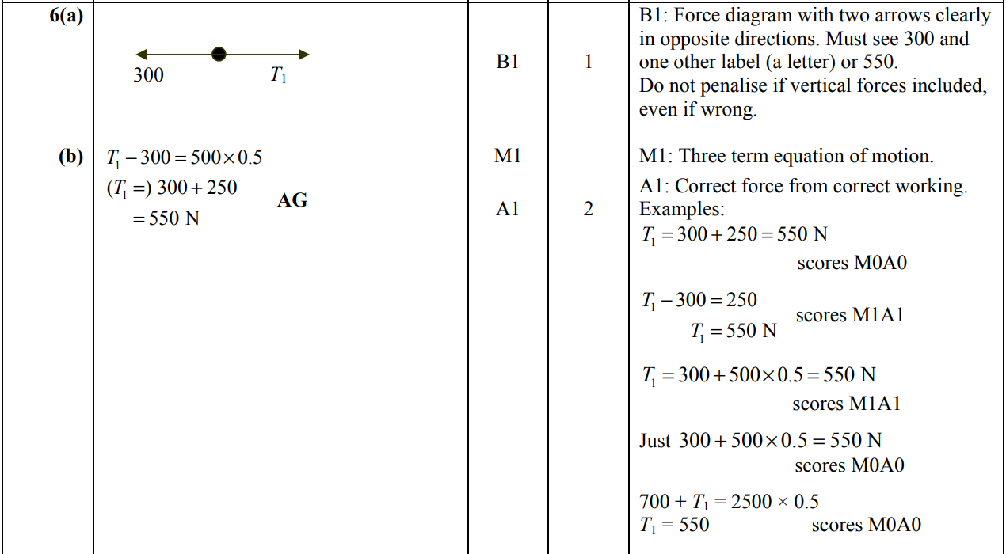
Coupling Forces 4 Exercise
Q5.
© AQA Jan 10

Slide 52
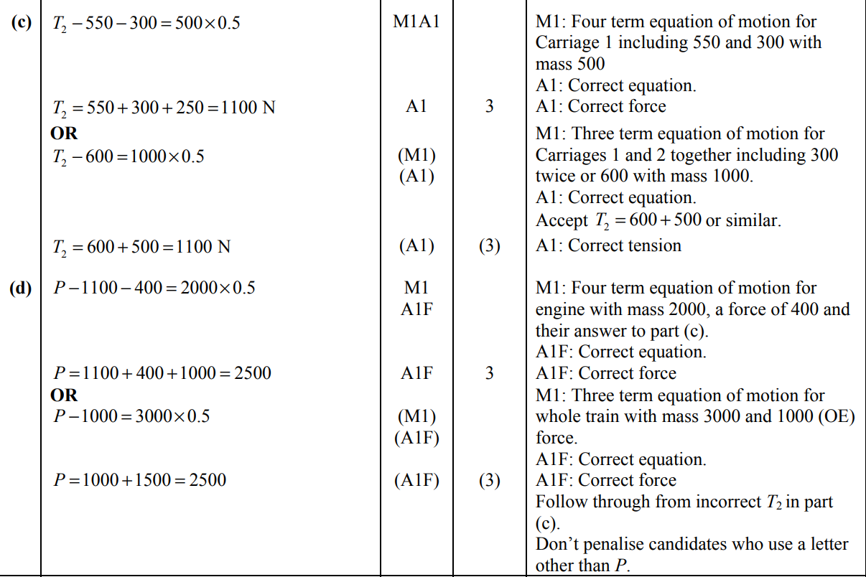
Coupling Forces 4 Exercise
Q5.
© AQA Jan 10

Slide 53
Coupling Forces 4 Exercise
Q6.
© AQA Jan 12

Slide 54
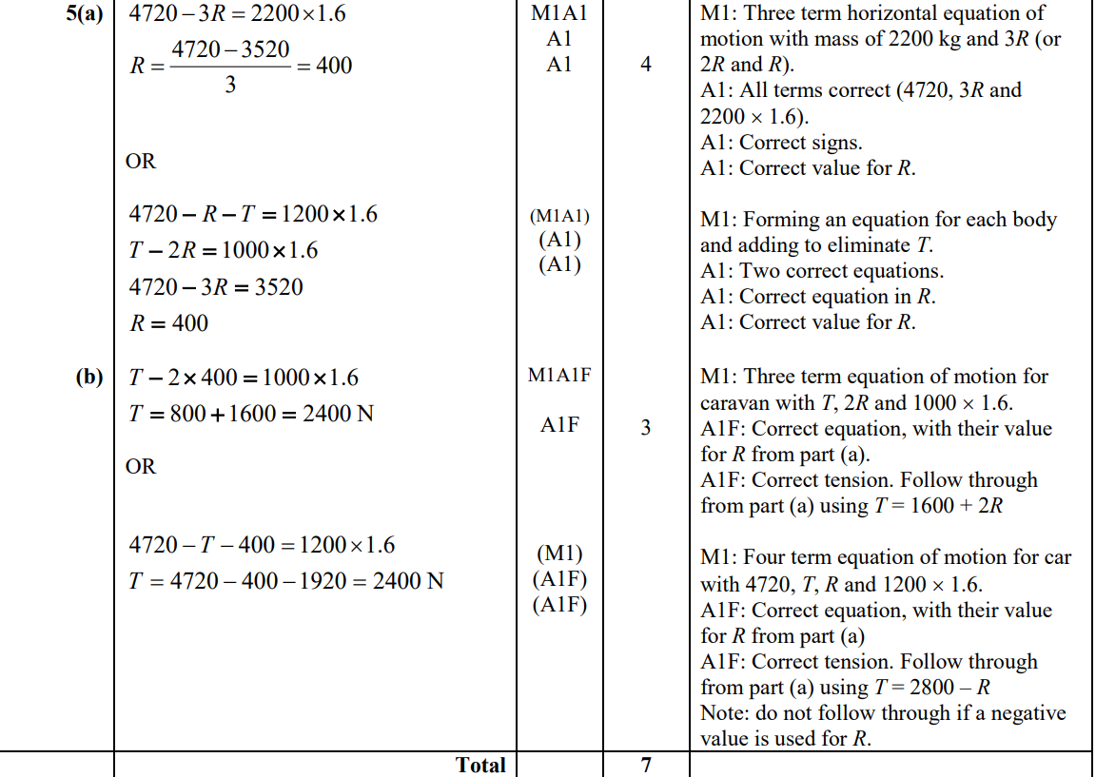
Coupling Forces 4 Exercise
Q6.
© AQA Jan 12

Slide 55
Objects in Contact
Connected Particles
Objects in contact
Mechanics

Slide 56
Connected Particles 4 key facts
Newton’s 3rd Law
If object A exerts a force on object B, then object B exerts a force of equal magnitude but in the opposite direction on A.
Object A
Object A
Object B

Slide 57
Objects in Contact 4 Example-Problem Pairs
1
1E.
Bill is standing on a lift platform. He has a mass of $82 kg$ and the lift platform has a mass of $125 kg$. The lift platform is suspended by a light, inextensible vertical cable.
Bill and the platform are accelerating upwards at $0.4 {ms}^{−2}$.
2
3
(a) Draw a force diagram to show each of the following:
(i)
The forces acting on Bill.
(ii)
The forces acting on the Bill and the lift together (by treating them as a single particle).
(iii)
The forces acting on the lift.
(b) Calculate the normal reaction force which acts on Bill.
(c)
Calculate the tension in the rope which is raising both Bill and the lift platform.

Slide 58
Objects in Contact 4 Example-Problem Pairs
1
1E.
2
(a)
Bill
Bill and Lift Combined
Lift
3
🗸
$$\text{R}$$
$$\text{T}$$
$$\text{T}$$
🗸
🗸
🗸
🗸
🗸
82g
207g
R+125g
R
🗸
🗸
Normal contact force acting on Bill (from lift)
R
Normal contact force acting on the lift (from Bill)

Slide 59
Objects in Contact 4 Example-Problem Pairs
(b)
Bill
$$\text{R}$$
🗸
82 kg
🗸
82g
(c)
Whole System
🗸
🗸
$$\text{T}$$
207 kg
Note that we could have used the lift on its own:
207g

Slide 60
Objects in Contact – Practice Questions
Suggested time: 30-40 minutes.
Where required, use $g=9.8 {ms}^{−2}$.
Check your answers using the solutions
Question(s) | Notes
1-2 | Standard questions
3-4 | Require a little more thought

Slide 61
Objects in Contact – Practice Questions
Q1.
A man of mass $80 kg$ is standing in a lift of mass $400 kg$. The lift is suspended by a single vertical cable and accelerates upwards at $0.8 {ms}^{−2}$.
(a) (i)
State two assumptions you should make about the cable in order to model the motion of the lift.
(ii)
Find the tension in the cable.
(b)
Find the magnitude of the normal reaction force exerted on the man by the floor.

Slide 62
Objects in Contact – Practice Questions
🗸
Q1.
🗸
(a) (i)
The cable is light and inextensible.
(a) (ii)
Whole System
$$\text{T}$$
🗸
🗸
480g
(b)
Man
$$\text{R}$$
🗸
🗸
80g

Slide 63
Objects in Contact – Practice Questions
Q2.
A lift of mass $380 kg$is supported by a vertical cable. A woman of mass $70 kg$ is standing in the lift. The lift is accelerating downwards.
The lift exerts a reaction force of $630 N$ on the woman.
Calculate the tension in the cable.
Begin by considering the forces acting on the woman only.

Slide 64
Objects in Contact – Practice Questions
🗸
Q2.
🗸
Woman
$$\text{630 }\text{N}$$
70g
Whole System
$$\text{T}$$
450g

Slide 65
Objects in Contact – Practice Questions
Q3.
A winch is lowering a crate of mass $40 kg$ into a hole using a light inextensible cable. The tension in the cable is $400 N$.
The crate contains a food parcel, as shown in the diagram. The crate exerts a reaction force of $12 N$ on the food parcel.
(a) Calculate the acceleration of the crate.
(b) Calculate the mass of the food parcel.
crate
food parcel
The magnitude of the reaction force acting on the crate from the parcel is equal to the magnitude of the reaction force acting on the parcel from the crate.

Slide 66
Objects in Contact – Practice Questions
🗸
Q3.
🗸
(a)
Crate
$$\text{400 }\text{N}$$
🗸
🗸
(b)
Food Parcel
12 N
mg

Slide 67
Objects in Contact – Practice Questions
Q5.
A shipping container of mass $150 kg$ is suspended from a light, inextensible cable. Stacked inside the container are two boxes, A and B, of masses $450 kg$ and $600 kg$ respectively. Box A is on top of box B.
The container is raised with an acceleration of $0.2 {ms}^{−2}$.
A
B
(a)
Calculate the tension in the cable.
(b)
Find the normal reaction force exerted by:
(i)
Box B on box A.
(ii)
The container on box B.

Slide 68
Objects in Contact – Practice Questions
🗸
🗸
(a)
Whole System
T
🗸
🗸
(b) (i)
Box A
450g

Slide 69
Objects in Contact – Practice Questions
🗸
Q4.
🗸
(b) (ii)
Box B

